Slide 1

All Mos Amplifier
CMOS Amplifier using All MOS Philosophy – Qualitative Approach

Slide 2
Motivation
Biasing - proper operation. Discrete circuits - voltage divider network at the input side.
Integrated circuits - Power is a constraint.
Capacitors occupy a large area relative to that of a transistor.
How do we a build an amplifier without the use of resistors and capacitors?
Only Pico farads are feasible.
Resistor need bypass capacitors

Slide 3
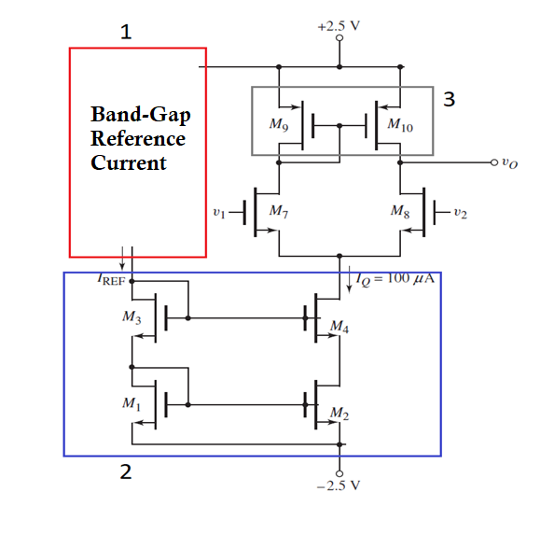
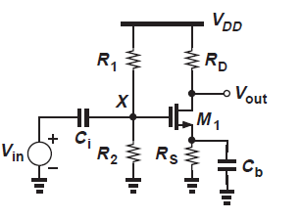
Our goal
Upgrade
Discrete type Common Source Amplifier
Integrated type Amplifier

Slide 4
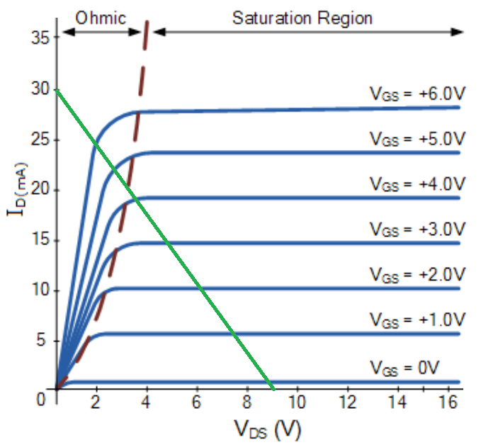

Review of E – mosfet
E – MOSFET – Channel is formed due to positive Gate-Source Voltage
For E – MOSFETS, Saturation condition: $V_{GS}− V_{TH}≤ V_{DS}$
${ V}_{GS} ≥ V_{TH}$
MOSFET Amplifier has to be
maintained in the Saturation condition

Slide 5
Topologies needed
We need six important concepts or topologies to build such an amplifier:
Dual power supply
Differential pair
Current source biasing
Current source load – Active load
Current mirror
Cascoding of transistors

Slide 6
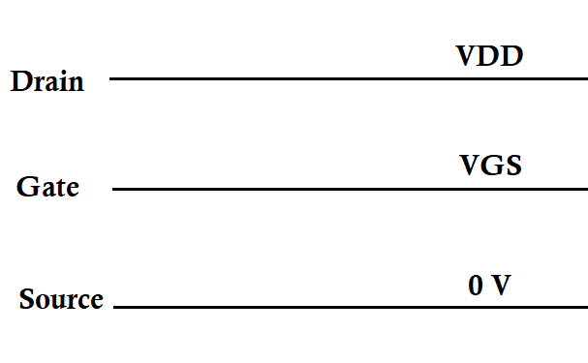
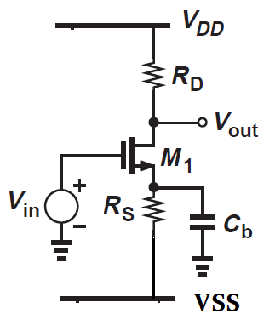
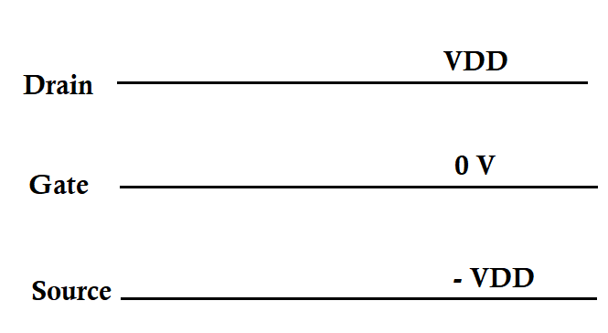
1. Dual power supply
1. Voltage Divider
2. Dual Power Supply
Notes:
DC Analysis

Slide 7

1. Dual power supply
Applying KVL to the input side,
Bias current: I_{SS} $= \frac{(− V_{GS}− V_{ss})}{R_{S}}$
where V_{SS} = -V_{DD}

Slide 8
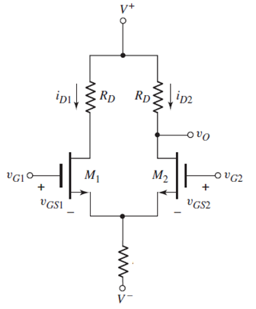
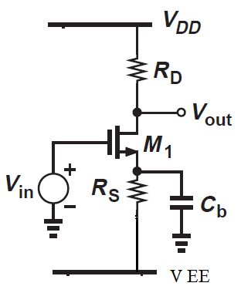
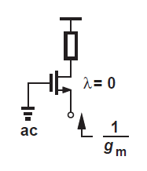
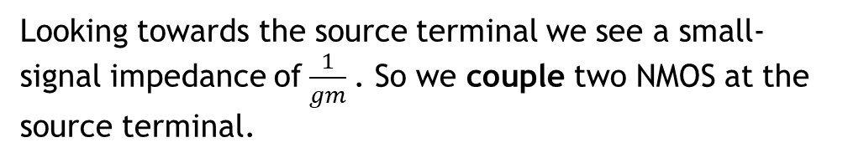
2. Differential pair
We need a device that provides low-impedance path to ac.
Looking towards the source terminal we see a small-signal impedance of$\frac{1}{gm}$. So we couple two NMOS at the source terminal.

Slide 9
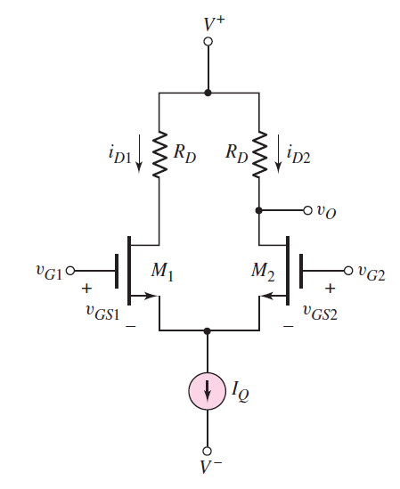
3. Current source biasing
Replace bias resistor with a current source

Slide 10
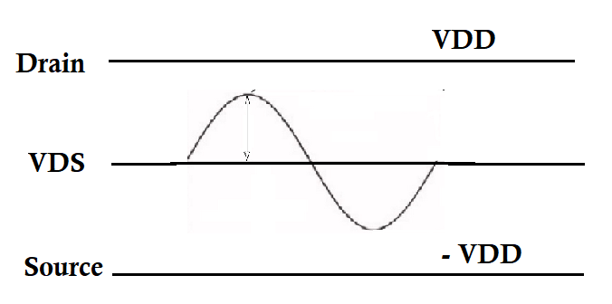

4. Active Load
Output Gain =$−{ g}_{m}∗R_{D}$
R_{D} is used to provide gain but also provides a voltage drop.
When seeing through the Drain Terminal, ro due to channel length
Modulation.

Slide 11
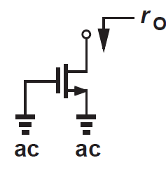
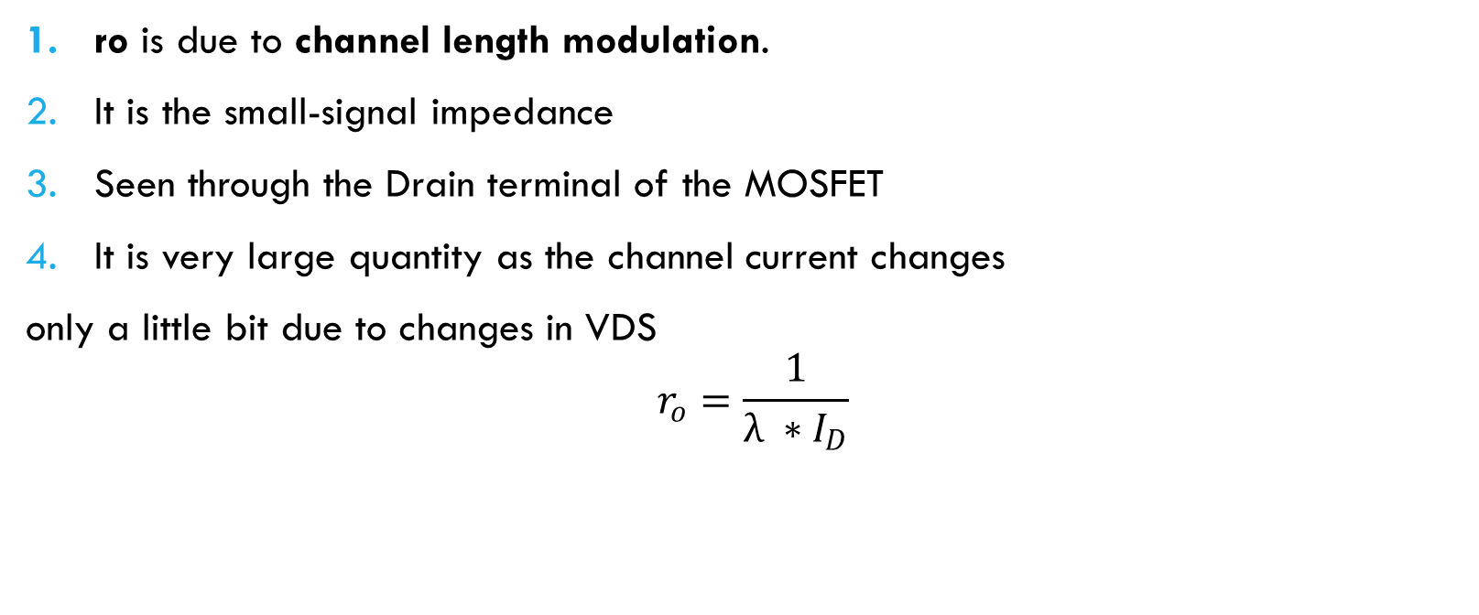
4. Active Load
ro is due to channel length modulation.
It is the small-signal impedance
Seen through the Drain terminal of the MOSFET
It is very large quantity as the channel current changes
only a little bit due to changes in VDS
$$r_{o}=\frac{1}{λ ∗{ I}_{D}}$$

Slide 12
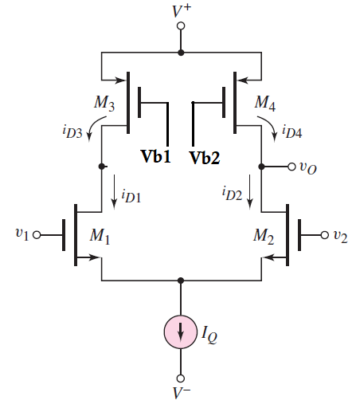
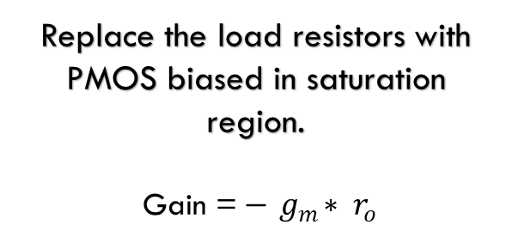
4. Active load
Replace the load resistors with
PMOS biased in saturation
region.
Gain =$−{ g}_{m}∗ r_{o}$
ro = ro4 || ro2

Slide 13
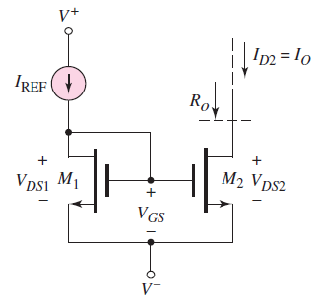

5. Current Mirror
A current source is usually created by using a band-gap reference circuit.
But it is highly complex and requires many transistors.
We wish to make copies of this is
“Golden current source”.

Slide 14
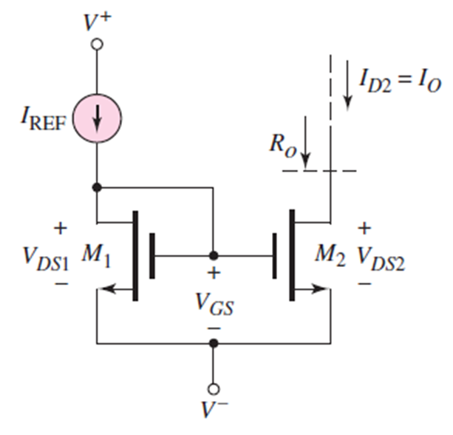
5. Current Mirror
M₁ acts as a diode-connected transistor.
V_{GS} of M₁ will have a square-root relationship with
that of I_{REF.}
Since the gate-source voltage of both the MOSFETS
are the same V_{GS}, it is inferred that they will have
same drain current.
Diode-connected MOSFET is always in saturation.

Slide 15
5. Current Mirror
Use the current mirror as the bias current.

Slide 16
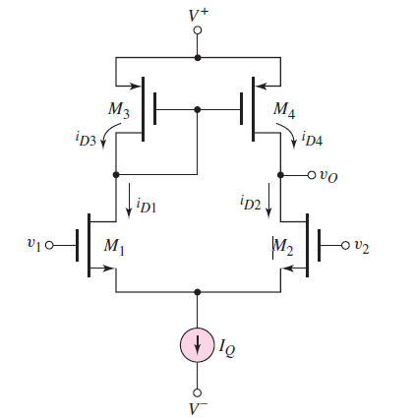
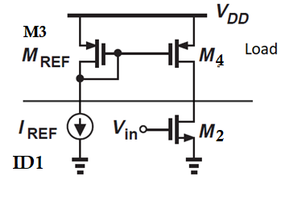
5. Current Mirror
Use a current mirror for the load also
Current through M3 taken as the reference current
And it is mirrored into M4 using current mirror.

Slide 17
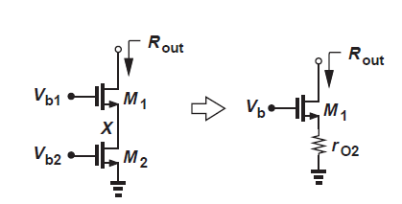
6. Cascoding of transistos
To increase the stability against supply distortions and to increase the impedance of a current-source load.
We stack MOSFETs on top of each other.
All of them are biased in saturation region.
R_{out} ~ g_{m1} * r_{O1} * r_{O2}
The output impedance is proportional
to the intrinsic gain of the cascode device.

Slide 18
Final Circuit
1 – Reference current: This is used to establish the reference current.
2 – Cascode Current Mirror Circuit: This is used to establish the bias current or the drain current of the differential pair. It gives large output resistance
3 – Active load: This topology uses PMOS current mirror as the active load.

Slide 19
Thank you
Hope you enjoyed my presentation!

